Slide 1

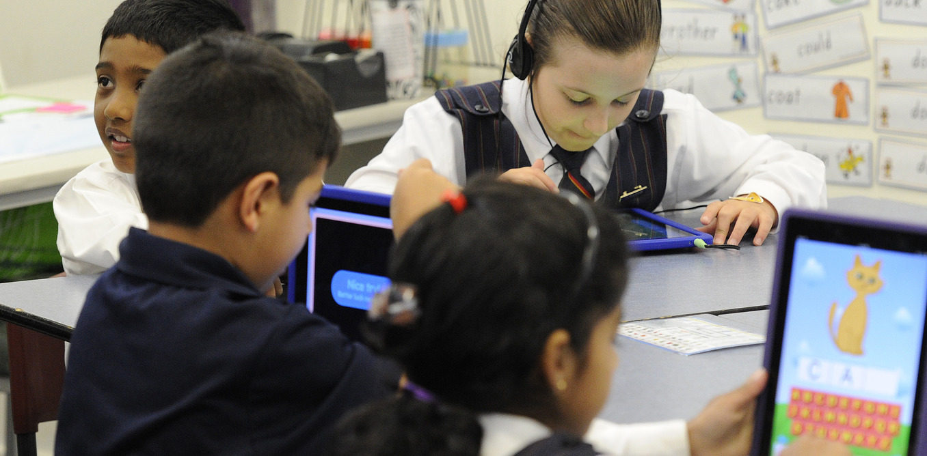
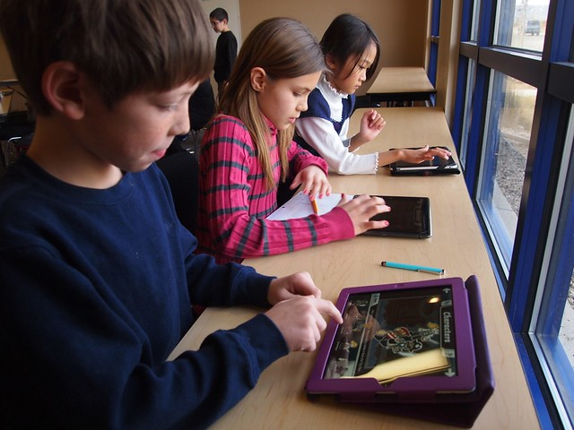

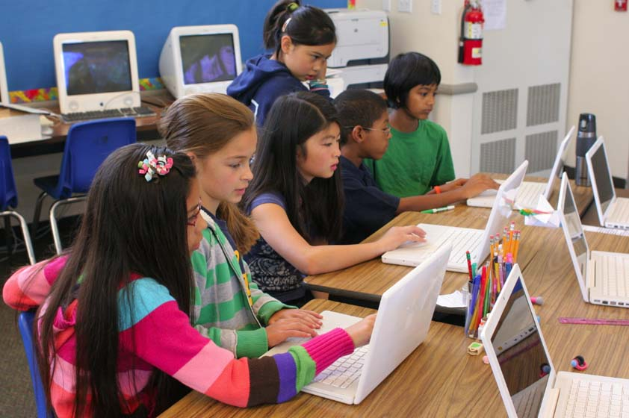
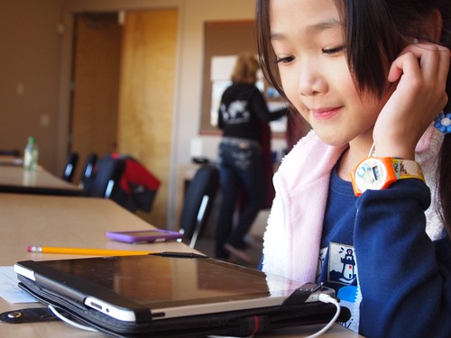

Keeping Kids Safe Online
Presented by:
PCS Digital Learning

Slide 2
10 Tips for Keeping Your Child Safe Online
1. Screen Time Limits
2. Keep it Visible
3. Sharing Information
4. 1,2,3 Beware
5. Password & Security
6. Cyber Bullying
7. Online Predators
8. Social Media
9. Monitoring Your Child
10. Keep Communication Open

Slide 3
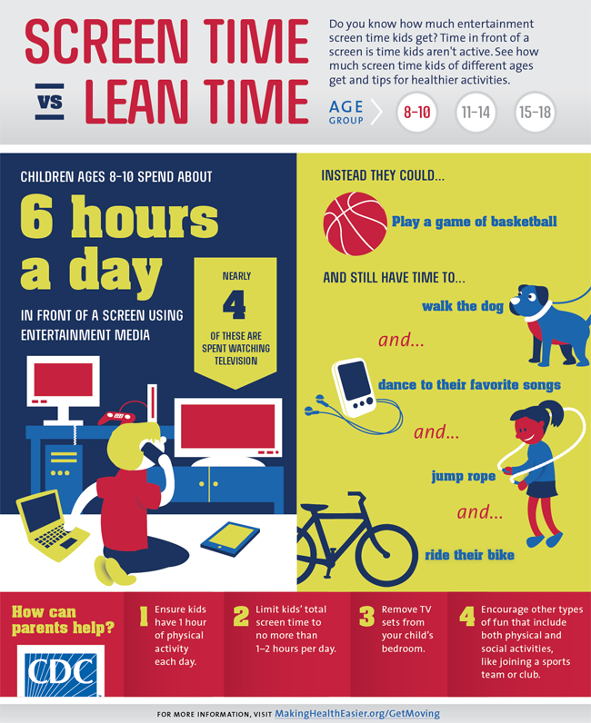
Healthy Screen Time Limits
Click Here to see your Infographic by age!
Setting screen-time limits -- and helping kids moderate their own habits -- are all about finding the right balance for your family's needs and lifestyle.
How can Parents help:
Ensure kids have at least 1 hour of physical activity each day
Limit kids’ total screen (beyond online learning) to no more than 1-2 additional hours per day
Remove TV sets from your child’s bedroom
Encourage other types of fun that include both physical and social activities, like joining a sports team or club.
Current Statistics:
Ages 8-10: 6 hours a day
Ages 11-14: 9 hours a day
Ages 15- 18: 7.5 hours a day

Slide 4
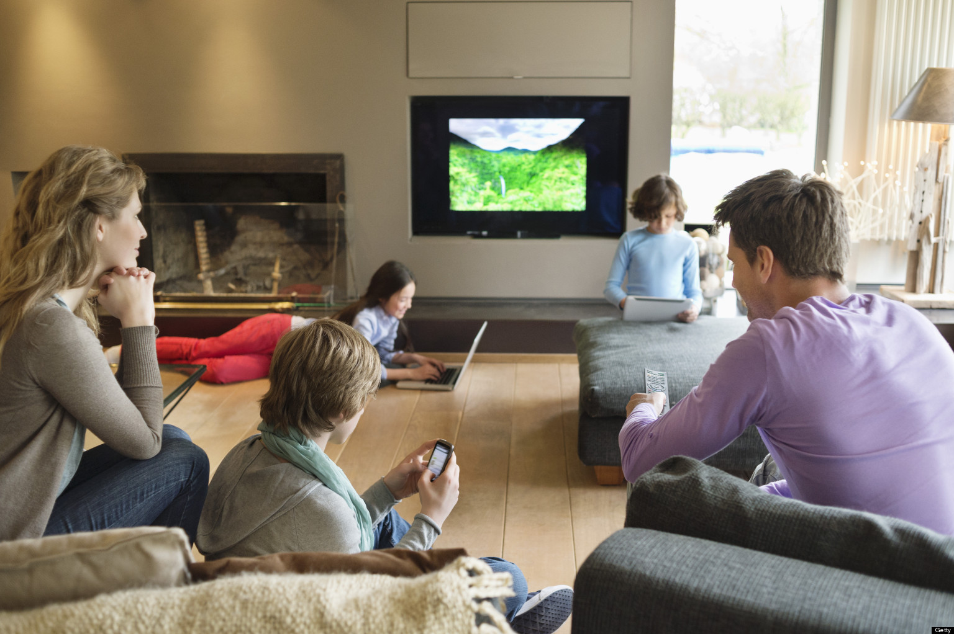


Keep it Visible
Set up your child’s computer in common areas or high traffic areas where you can see their screen easily.
Create a family charging station where all devices are stored at night before going to bed.
Some areas that your family might find convenient are: Living Room, Dining Room, Home Office, or even the Kitchen Table.
Living Room
Dining Room
Home Office
Kitchen Table

Slide 5

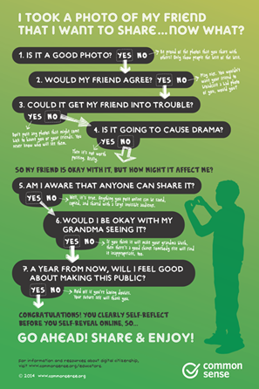
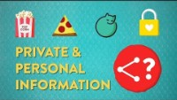
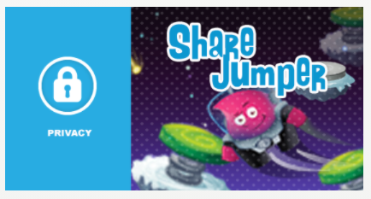


Sharing Information
Personal Information:
Your favorite color or food, pets that you have, hobbies or interests that you have.
Private Information:
Your full name, date of birth, address or the school you attend.
Click here to play Share Jumper
Students evaluate examples of online messages and decide what information is appropriate to share, and when.

Slide 6

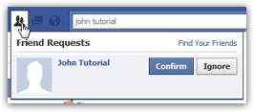

1, 2, 3 Beware!
Downloading malware. Kids who download free games, music, ringtones or apps may be installing viruses or malware on their device that can damage it or infiltrate it to gain access to personal information.
Scams. Criminals may entice children to buy things online or they may offer goods for “free” in exchange for more personal information.
Accepting “Friend Requests”. Make sure you and your child have a plan in place to identify which friend requests are “Real”. Rules for accepting family and friends only.

Slide 7
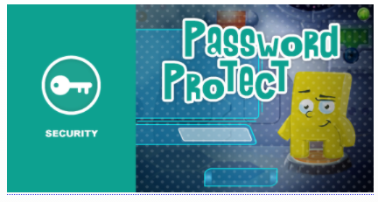
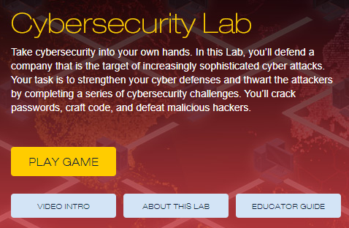
Passwords & Security
Here is a fun game kids can play:
Kids need to know about the dangers of sharing their password with others and how to create safe and secure passwords.
Creating a Strong Password:
Create passwords that are easy to remember but hard to guess.
Passwords should be at least 8-10 characters long
Include numbers, capital letters and symbols
Consider using a password manager (such as LastPass)
Try not to use the same password for multiple sites
Click here for PCS Recommendations
Learn what components make a password secure.
Identify ways they can create a memorable but secure password.
Create a secure password.
Click to Play

Slide 8
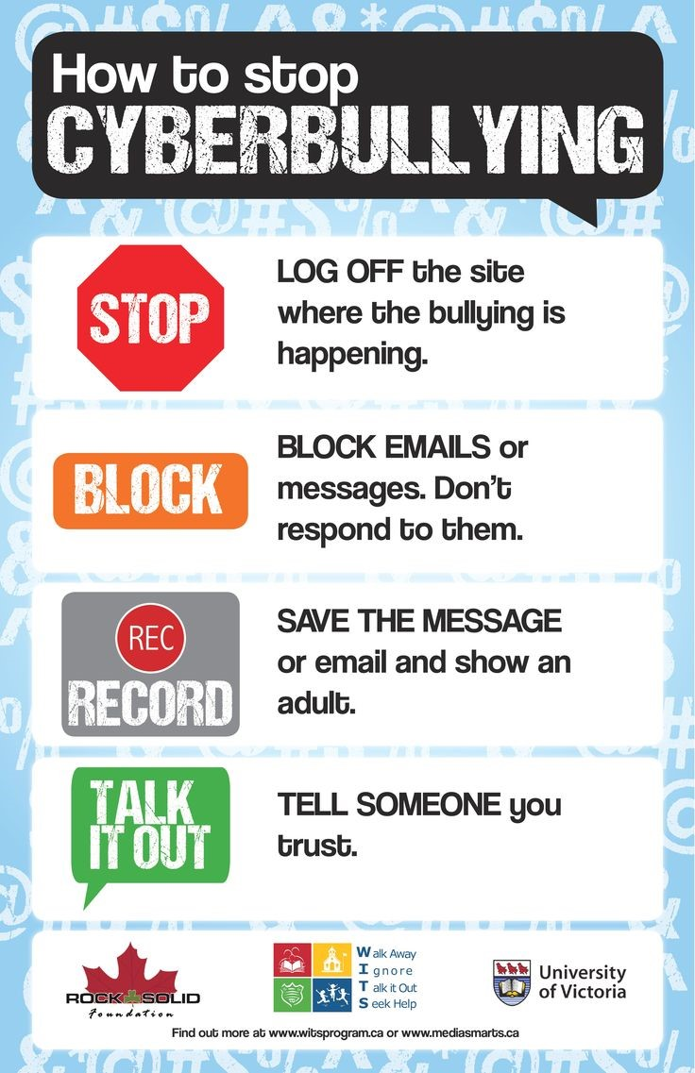
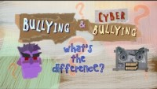
What is Cyber Bullying?
Cyberbullying is a type of bullying that takes
place over cellphones, computers, and tablets. It can occur privately between the offender and the victim or more globally through social media, public forums or during gaming. It consists of sending, posting or sharing negative , harmful, false or mean content about another person.

Slide 9


More on Cyber Bullying
Once kids go online, their chances of finding cyberbullies, haters, and trolls is, sadly, quite high. Find age-specific guidelines, videos, and articles to help with tough conversations -- whether your kid is a bully or is being bullied. Click Here to real the full article.
Click here to play this game!
Click here for
Bullying & Cyberbullying Resources
Compare different forms of cyberbullying and the roles of those involved.
Interpret scenarios that illustrate the importance of empathizing with targets of cyberbullying.
Identify ways to be an upstander when cyberbullying occurs.

Slide 10
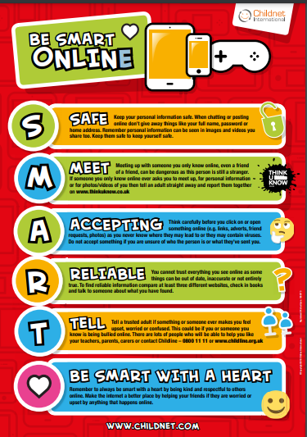
Online Predators
Click here to download
The Internet is much more anonymous than the real world. People can hide their identities or even pretend to be someone they're not. This can sometimes present a real danger to children and teens who are online.
Choose appropriate, modest screen names and photos
Use caution when sharing personal/private details/photos
Remember you don’t always know the person behind the screen
Stay safe and NEVER agree to meet online acquaintances, face to face
Find a trusted adult if you encounter any problems
Click Here for the Full Article

Slide 11




Social Media
GOOD
Stay in touch with friends/family & connect to others
Keep memories alive
Teach others & share new ideas
BAD
Provides a forum to overshare private information
Can lead to cyberbullying
Can make your child vulnerable to online predators
SOCIAL MEDIA SIMULATION
Practice digital literacy skills in a social media simulation
TestDrive is designed for upper elementary school.
It provides a simulated experience of realistic digital dilemmas and scenarios, along with key concepts and strategies for navigating them.
Try it here: https://socialmediatestdrive.org/modules.html

Slide 12

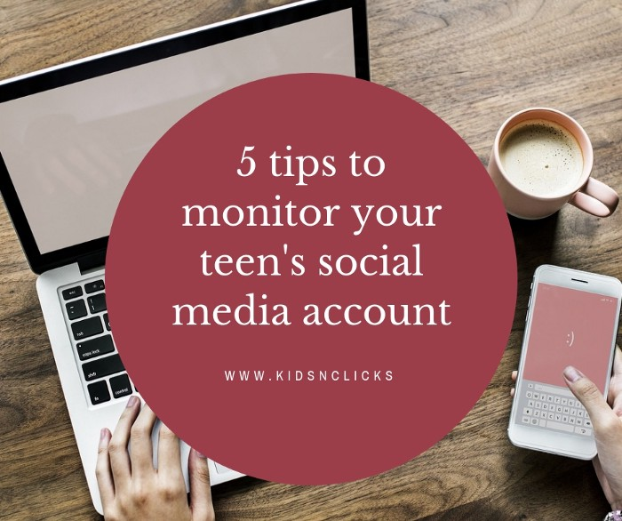


Monitoring Your Child
Ultimately it is a family decision on how you will monitor your child’s online activities.
Here are some tips:
Use the apps they are using
Research popular apps or check common sense media for age suggestions and reviews
Talk regularly to your child about online safety
Set internet rules and regulations
Monitor by age, maturity, and use parental controls
There are many apps and services out there that allow you to monitor your child’s use of social media and phone use in general. We are not endorsing any specific product but here are a few and their approx. cost to you.
Bark: Cost $14 per month or $99 a year
Qustodio: Cost from $55 to $138 a year
Net Nanny: Cost $30 to $80 a year
5 tips to monitor your child’s online activities

Slide 13






Communication
One of the best things you can do to help keep your child safe online is to communicate with them.
Keep calm & respond openly
Establish rules, but also be flexible
Model responsible online behavior
Inform them of possible dangers

Slide 14
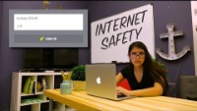
Let’s RAP(Wrap) it Up!

Slide 15



Slide 16
Additional Resources
For Parents:
The Parent’s Guide to Cyberbullying
Screen Time
Secure Password Tips
Facebook, Instagram, and Social
Social Networks for Kids
For Educators:
Common Sense Media Digital Citizenship Lessons
Social Media Simulation
For Scholars:
Common Sense Media Digital Passport Games

